Slide 1
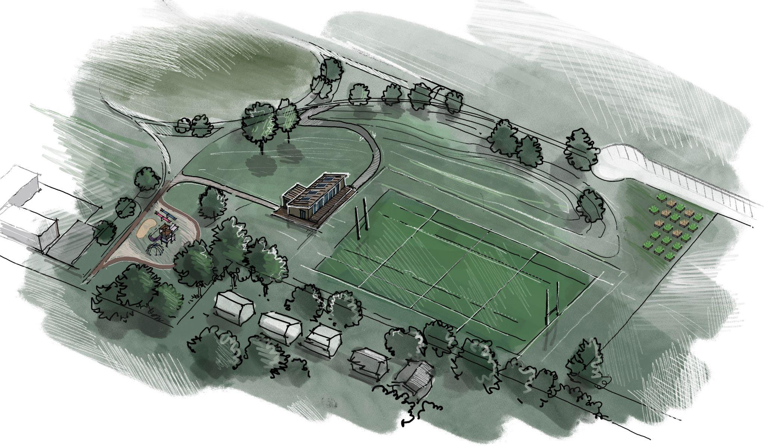
Gorsebrook Park Clubhouse Project

Slide 2
Includes
Public Washrooms
Change rooms/showers
Community space
Viewing Deck
Equipment storage

Slide 3
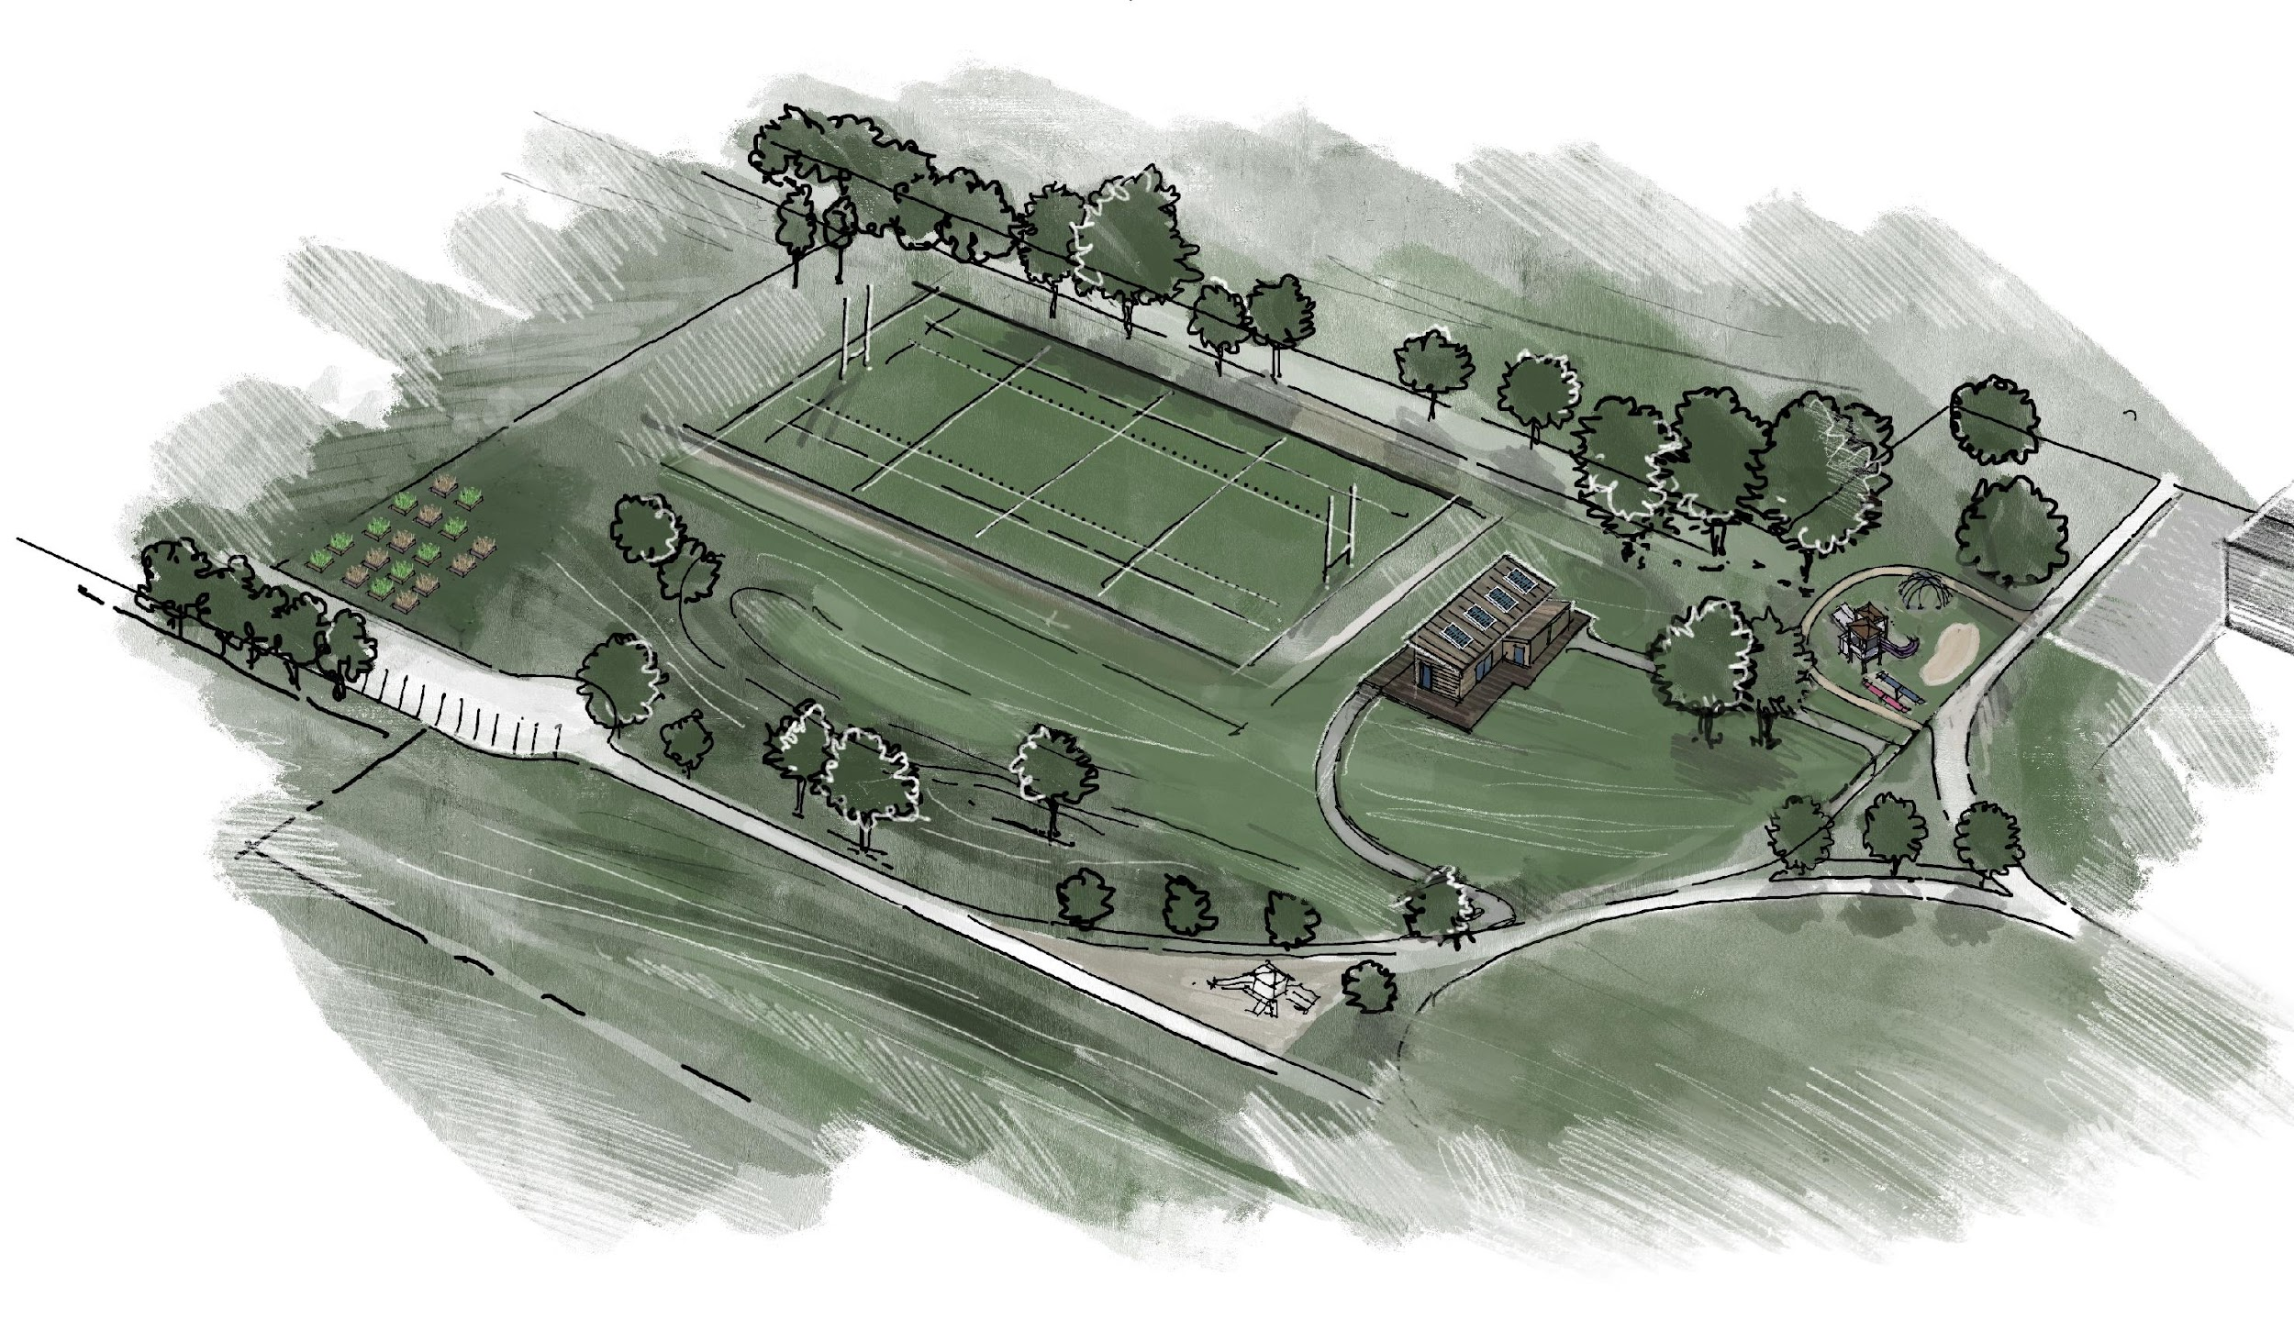
Project Values
Inglis Street
Community/ Club Development
Sustainability
Inclusivity
Respect for the neighbourhood
Accessibility
Clubhouse entrance
Public Washrooms

Slide 4
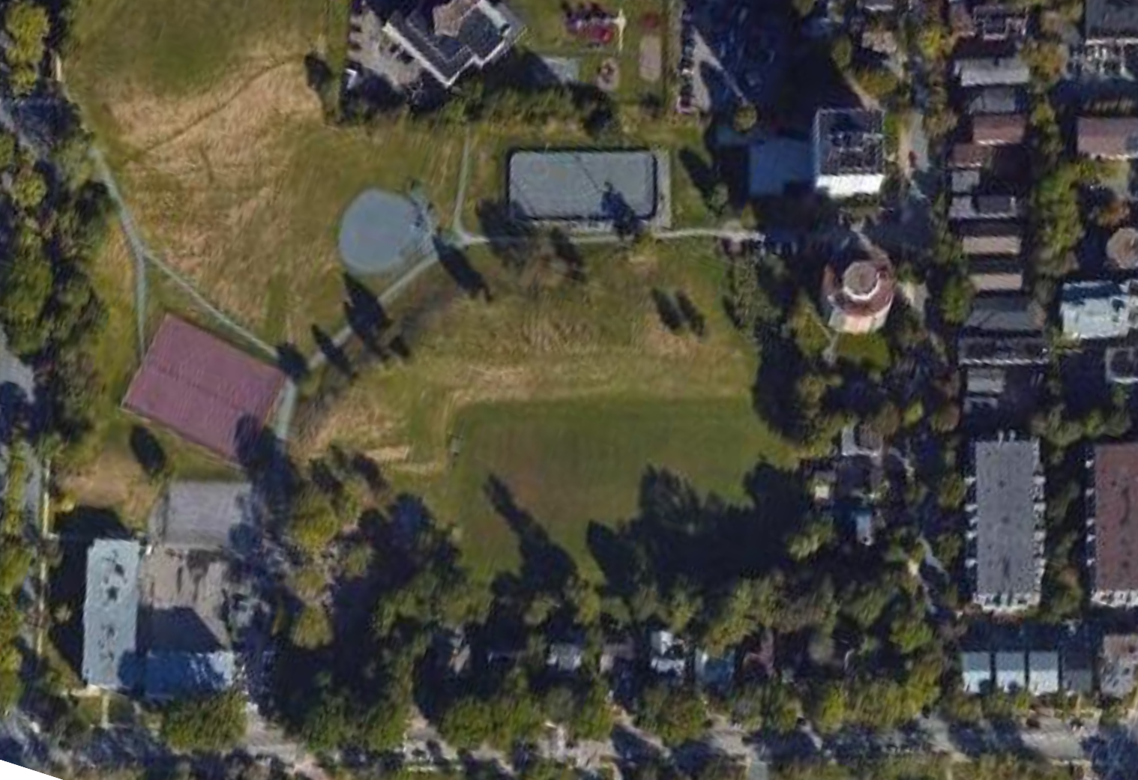
Proposed Location
Lacrosse/ Ball Hockey
Ball field
path
Tennis court
Community Garden
Robie St.
Clubhouse
Wellington St.
Public Washroom
Sports field
Basketball court
Playground
Inglis St.

Slide 5
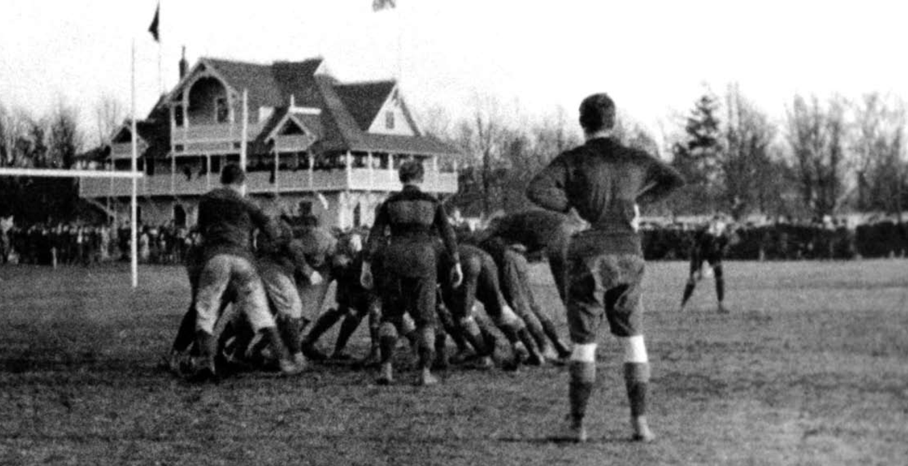
About Us
History
Founded 1958
The Oldest continuously operating Rugby Club in Nova Scotia
Longest running Women’s rugby program

Slide 6
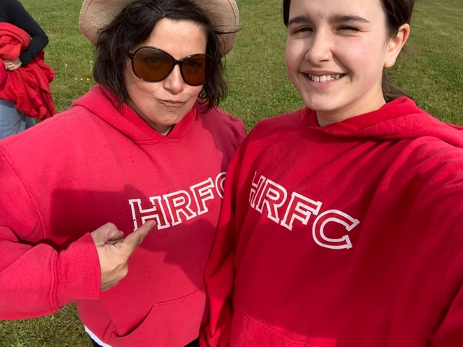
Leona and Maggie
About Us: Meet Our members
(Mother and Daughter)
“The Club has been a big part of over half of my life. Maggie joined the junior women’s squad as soon as she could”
Leona Burkey (Former player)

Slide 7
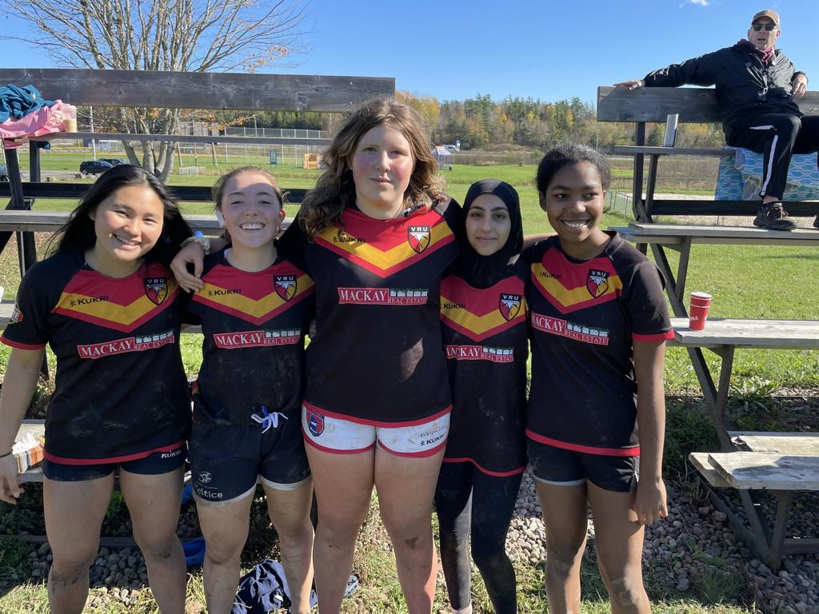
About Us
“One Big Club”
(Our Values)
Inclusive
Diverse
Welcoming

Slide 8
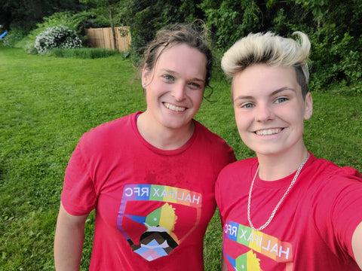
Megan
About Us: Meet Our members
“Everyone has a place, both in the game and in the community”
Megan Dunn,
Junior Women’s Player

Slide 9
192 Members
Including:
Contact Players
Non-contact players
Coaches
Social members (alumni, families and supporters)

Slide 10
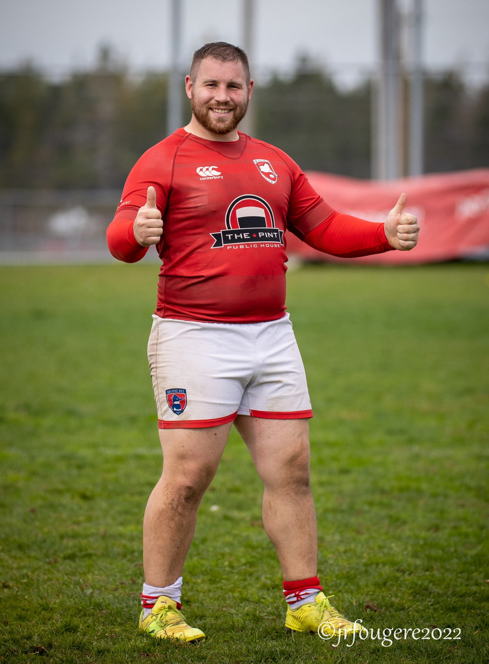
Myles
About Us: Meet Our members
“As someone on the Autism Spectrum, it’s hard to be yourself and fit in with sports. The club welcomes you with open arms and never judges anyone.”
Myles Knight
Senior Men’s Player

Slide 11
Programs
Senior Rugby
Women’s 1st & 2nd Division
Men’s 1st & 2nd Division
Junior Rugby
Junior Boys and Girls
Pride Rugby
For LGBTQ2S+ athletes
Rookie Rugby
Ages 4-12

Slide 12
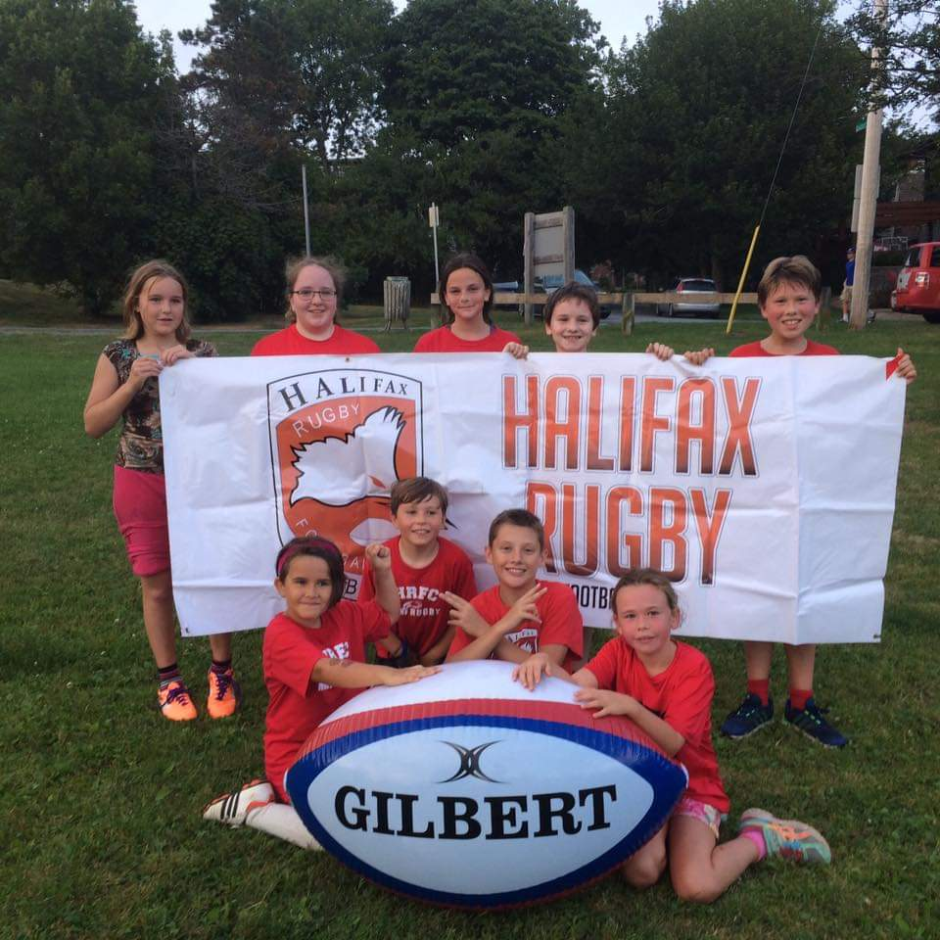
Rookie Rugby
About Us
“She is a quiet and timid kid; “I have never seen her more welcomed into a sport”
Sophie & Adam Russel (Rookie Rugby Parents)

Slide 13
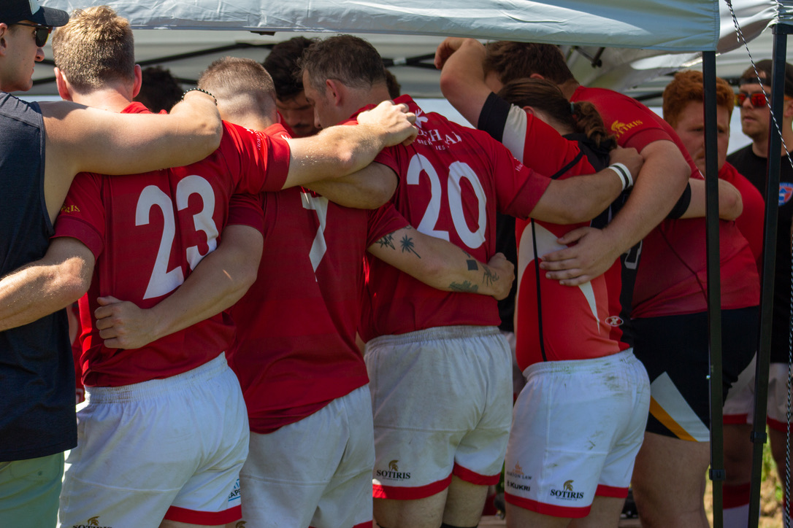
Rugby Builds
Community
In our club you’re instantly part of a community

Slide 14
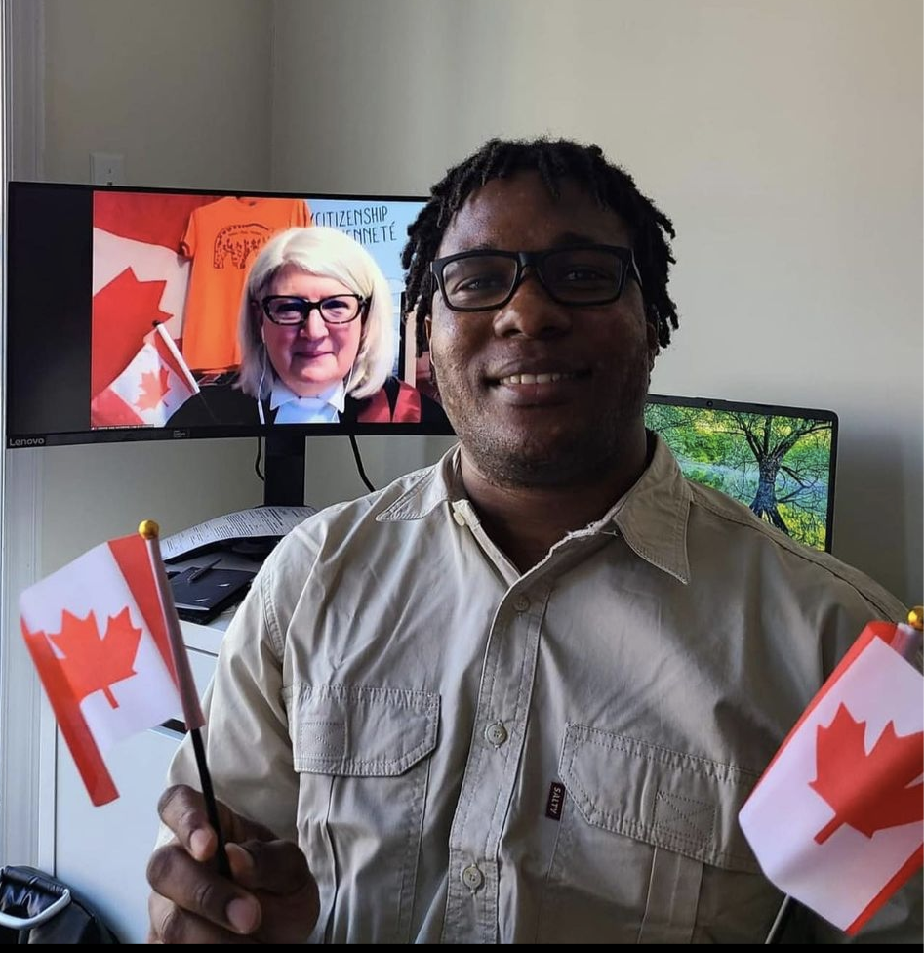
“Taps” (Zimbabwe)
About Us: Meet Our members
New Canadians
“I have made some good friends who have become family.”
Tapiwa Munyanyi,
Senior Men’s Player
Taps, the day he became a Canadian Citizen
Notes:
This is Taps. He joined the club in 2017. That picture was taken this past summer, the day he became a Canadian citizen.

Slide 15
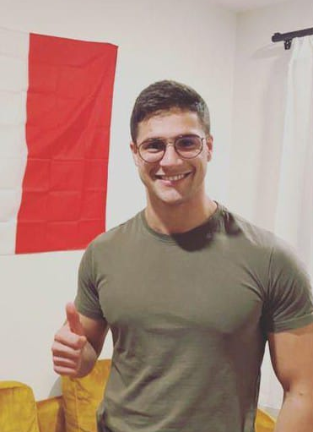
“The Breeze” (Italy)
About Us: Meet Our members
New Canadians
"It made me feel part of a community and helped me to integrate“
Fabrizio Contini
Senior Men’s Player
Notes:
This if Fabrizio. We saw him watching training one day in 2021. He’d just moved here to go to SMU. (click) He came to the next training session two days later and became part of the community.

Slide 16
Yoshi (Japan)
About Us: Meet Our members
New Canadians
“This team made me love Halifax.”
“If I hadn't joined the club, I would have found Halifax boring and would have moved to Toronto or Vancouver.”
Yoshiki Takamiya
Halifax RFC, 2022
Notes:
This is Yoshi. He arrived in Canada last winter and didn’t speak any English. He’s made our Club better and we’ve made his English better. (click) And, as you can see, we’ve helped keep him in Halifax.

Slide 17
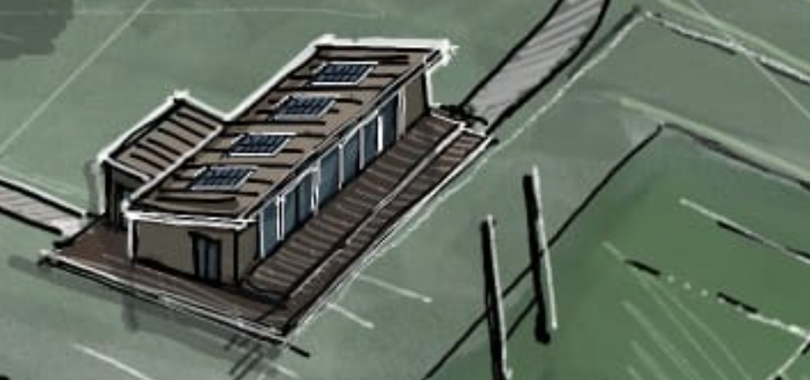
Emma
About Us: Meet Our members
"Every club I’ve played for overseas had a clubhouse. That’s how the sport builds community"
- Emma Taylor,
Veteran of Canada’s National team
Halifax RFC member since 2012

Slide 18
Timeline
2023
2024
2025
Public Consultation
Site Planning
Design and detailed costing
Site Development
Building Construction
Grand Opening

Slide 19
Potential Sport Users
Inglis Street
Lacrosse
Ball Hockey
Baseball
Disk Golf
Ultimate Frisbee
Touch Football
+ More
Clubhouse entrance
Public Washrooms

Slide 20
“I would like to express our strong support…A clubhouse, as proposed by Halifax Rugby, will allow Ball Hockey to continue to grow while creating a dynamic addition to our local community.”
Louis Brill
Halifax Minor Ball Hockey League
Founder and Managing Director
200+ children and their parents!
Notes:
Louis Brill from the Halifax Minor Ball Hockey League

Slide 21
Washroom & Drinking Fountain Strategy (2020)
Alignment with city priorities and plans
Gorsebrook is identified as a ‘high-need park’ for a public washroom

Slide 22
Gorsebrook Park Plan (2019)
Alignment with city priorities and plans
“The lack of publicly accessible washrooms and drinking water prevent the use of the park as a destination.”

Slide 23
Community Facility Master Plan 2
Alignment with city priorities and plans
✓ Accessibility and universal design
✓ Ensuring inclusivity for new Nova Scotians.
✓ Developing healthy citizens and children.
✓ Attracting and retaining new Canadians
✓ Partnerships help to build capacity, promote diversity

Slide 24
Green Network Plan (2018)
Alignment with city priorities and plans
“Incorporate year-round recreational infrastructure, including winter-oriented activities, when planning parks.”
“Enhance social gathering in municipal open spaces by encouraging limited private and not for profit commercial initiatives.”

